Slide 1
GDD: Project Asgard
Lev Yudchev
Rif Cafri

Slide 2
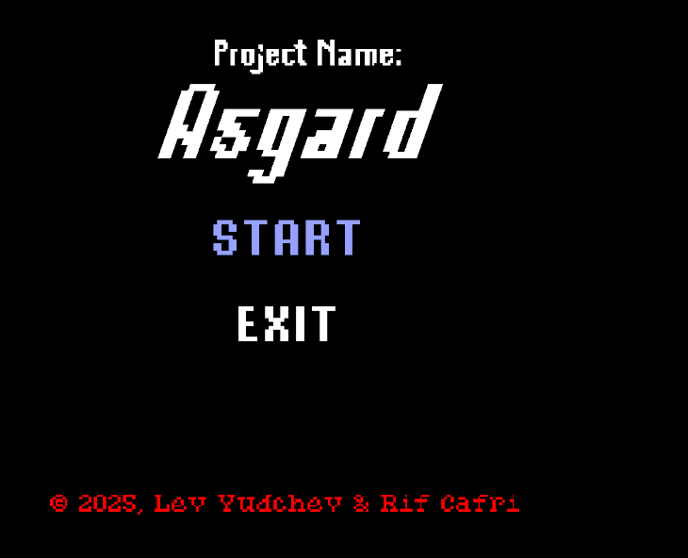
Menu Screen

Slide 3
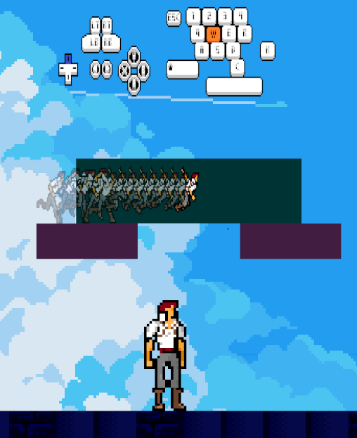
Game Tutorial

Slide 4
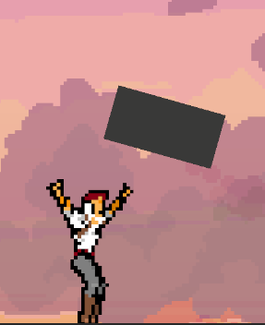
Use Of Hinge(Physics) – Spinning Platform

Slide 5
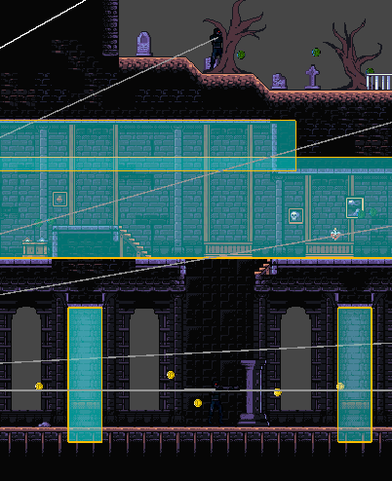
2 Floors House + Self Built Terrain

Slide 6
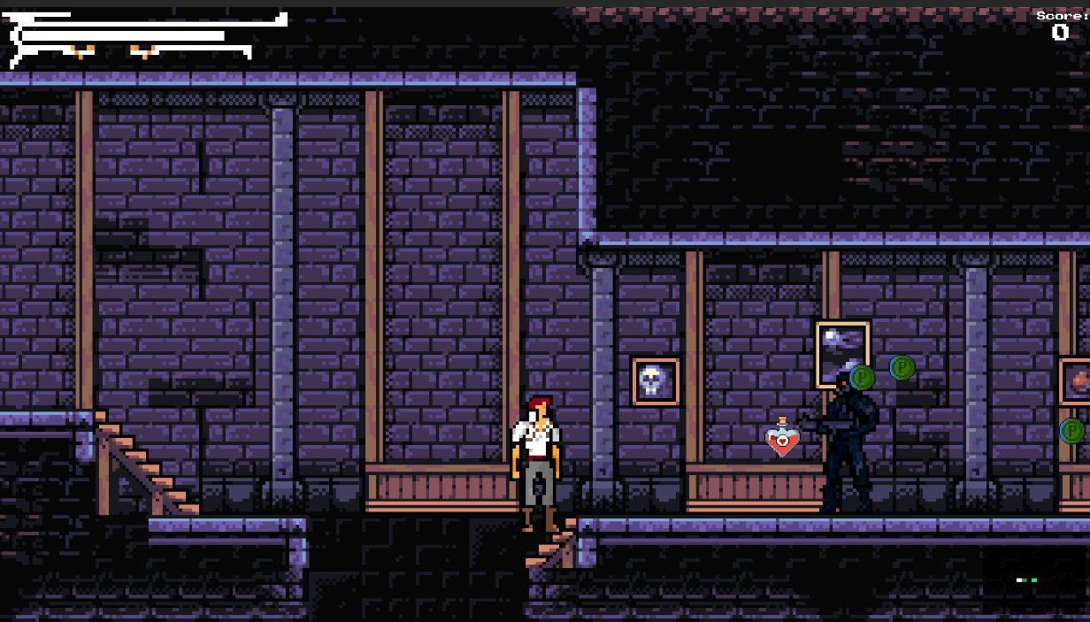
Life and Score

Slide 7
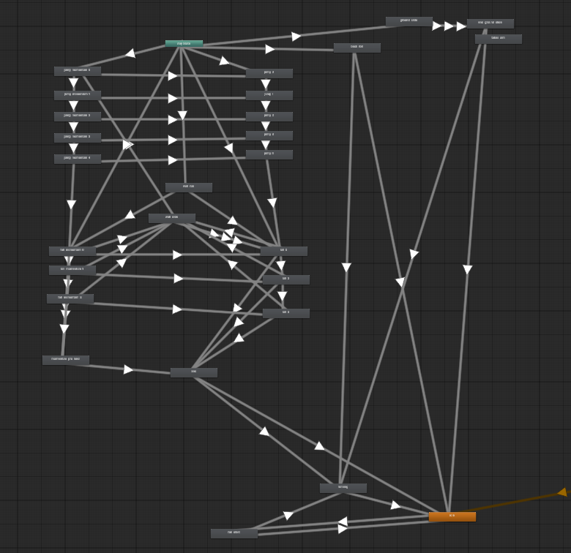
Animator with states

Slide 8
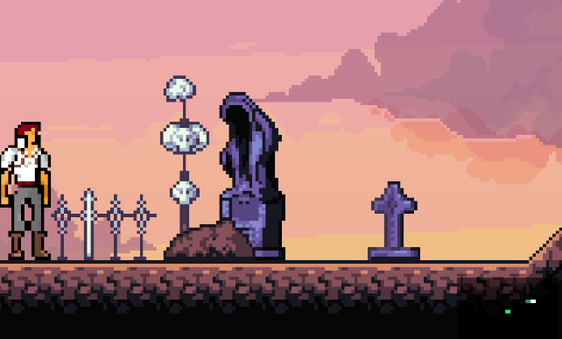
MINI-MAP

Slide 9

Additional requirements completed
LOD – Obstacles become blurrier as player moves away and clearer as a player approaches.
Robots with search,patrol, and chase behavior, fire multiple bullets, detect using raycast but cannot detect under certain conditions due to a layermask (for example, if there is a wall).
There are at least 3 collisions and 4 triggers.
There are at Least 2 Teleports in Different Random places, Life is restored and Score is saved
All Assets are self built
Scoreboard list with serialized parameters from different scenes(scores of each individual scene + collectibles)
First Person Camera to Third Person Camera switch included
Stealth mechanism included

Slide 10
Link To Game Repository On Github
Link for downloading from MEGA
https://github.com/Reef-7/ComputerVideoGamesCourseProeject/tree/main?tab=readme-ov-file

